Slide 1

P21 WWMS Optimization
March 18, 2026
An Epicor Platinum Elite Partner
Notes:
Andrew to do introduction
Plus logistics – how to ask questions,etc.

Slide 2


Andrew Taylor
Co-Founder, Chief Revenue Officer
Matthew Lucas
Senior Application Consultant, Warehouse Guru
Notes:
Andrew to do introduction

Slide 3


Agenda
01 | Warehouse Pain
02 | Warehouse Solutions
03 | Management Matters
04 | Case Study
05 | What’s your Score
06 | Next Steps & Give-away
07 | Q&A
Notes:
Andrew

Slide 4

Warehouse Pain
1
Inventory nobody fully trusts
2
Too much movement, not enough throughput
3
It’s a system of record, not a system of direction
4
Supervisors manage by feel, rather than data
5
The system makes working clunky and friction filled
Notes:
Matthew to handle this slide – animation works one at a time.

Slide 5
Solutions
Each of these levers exists in your system right now.
Notes:
Andrew to handle this slide

Slide 6
System managed inventory
The problem
Operators decide where inventory goes.
You get inconsistency, bin fragmentation, and a record the team stops trusting.
Notes:
Matthew’s slide – don’t linger on this – a simple re-statement

Slide 7
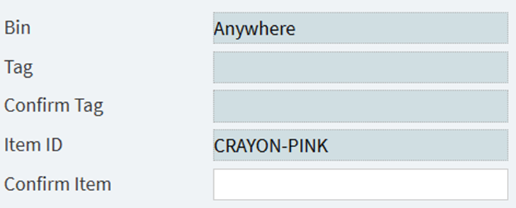
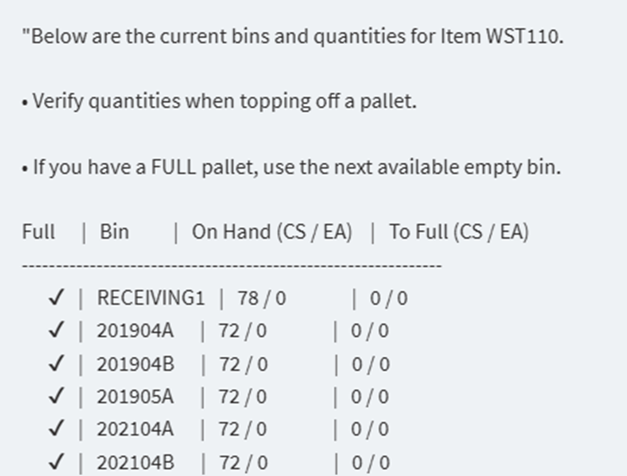
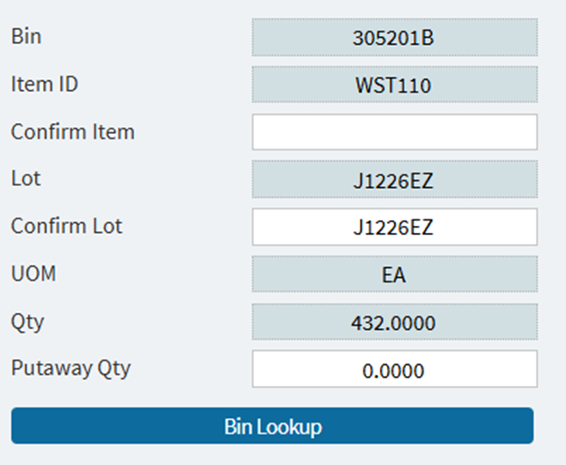

Inventory Levers
Notes:
Matt’s slide

Slide 8
System managed inventory
The problem
What changes
Operators decide where inventory goes.
You get inconsistency, bin fragmentation, and a record the team stops trusting.
System-directed putaway. Group putaway. Bin lookup.
The system decides. Every time. Regardless of who's on shift.
Notes:
Matt use’s this as a summary slide

Slide 9
Optimized warehouse layout
The problem
The warehouse is sequenced around the building - not around how inventory move.
Notes:
Matt’s slide to restate the problem

Slide 10
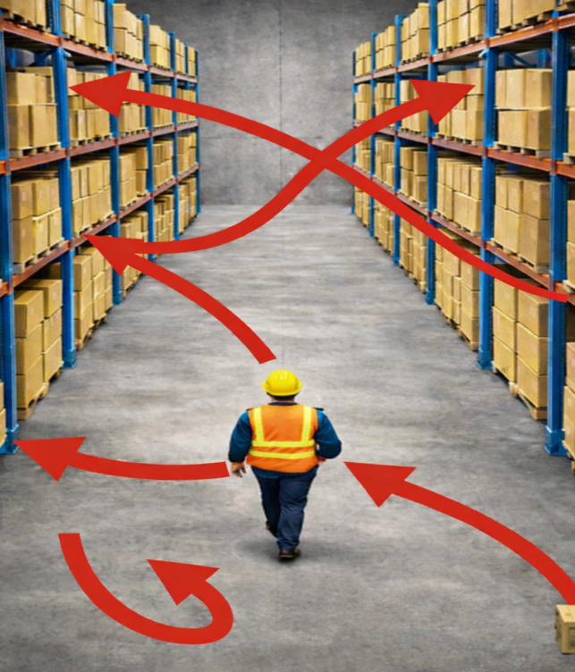
Sequencing Levers
Notes:
Matt’s demo slide

Slide 11
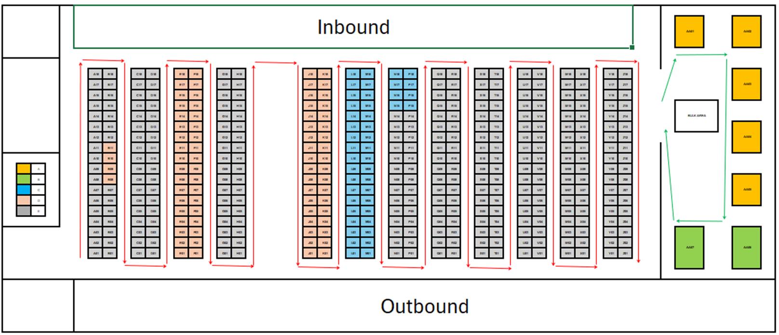
Sequencing Levers
Notes:
Matt’s demo slide

Slide 12
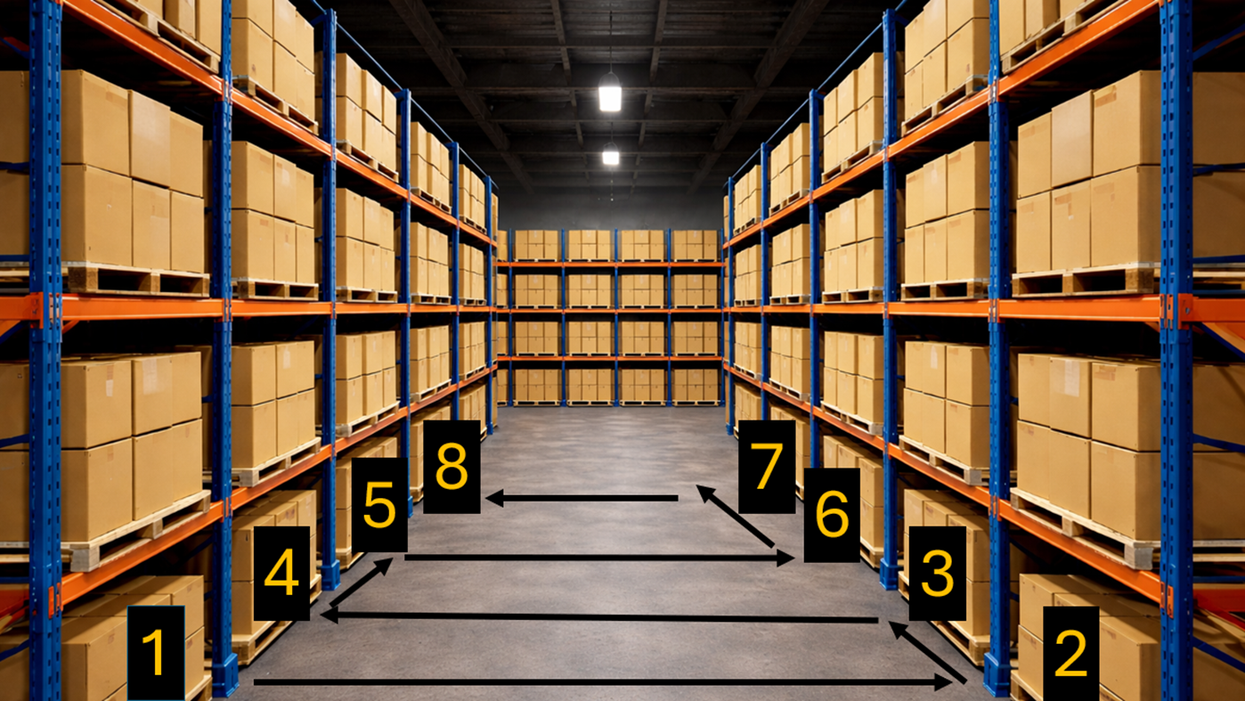
Sequencing Levers
Notes:
Matt’s demo slide

Slide 13
Optimized warehouse layout
The problem
What changes
The warehouse is sequenced around the building - not around how goods move.
Bin sequencing maps the logical travel path.
Zoning assigns work to the right equipment.
Fewer steps. Less backtracking. Same headcount.
Notes:
Serpentine path example works well here visually.

Slide 14
Real-time scan management
The problem
Transactions get entered after the fact.
The system records what happened.
It doesn't run the process.
Notes:
Matthew walks through a fully traced receiving workflow.

Slide 15

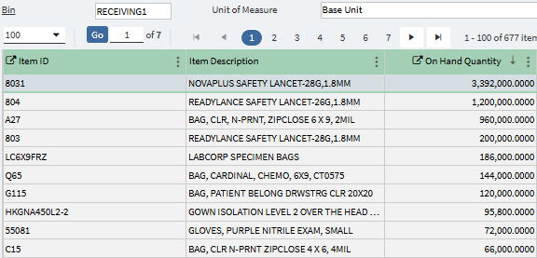

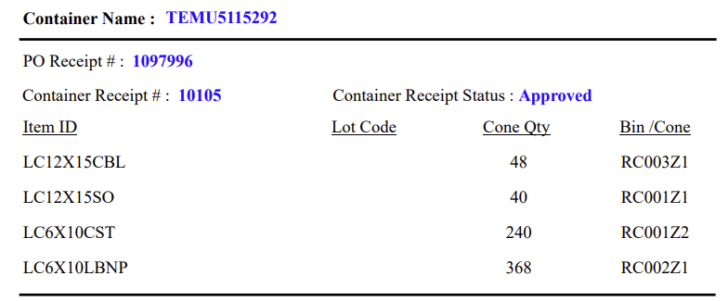
Scan Management

Slide 16
Real-time scan management
The problem
What changes
Transactions get entered after the fact.
The system records what happened.
It doesn't run the process.
Receiving to cone or license plate.
Scan verification at every handoff.
Same result regardless of who's working.
Notes:
Matthew’s summary slide

Slide 17
System visibility
The problem
Supervisor has to walk the floor to know what's happening.
Always one step behind.
Notes:
Mathew’s problem restatement slide

Slide 18
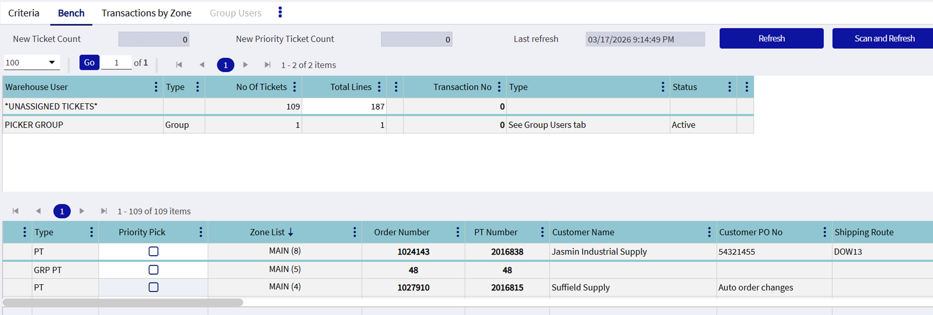
Creating Visibility
Notes:
Matt to show

Slide 19
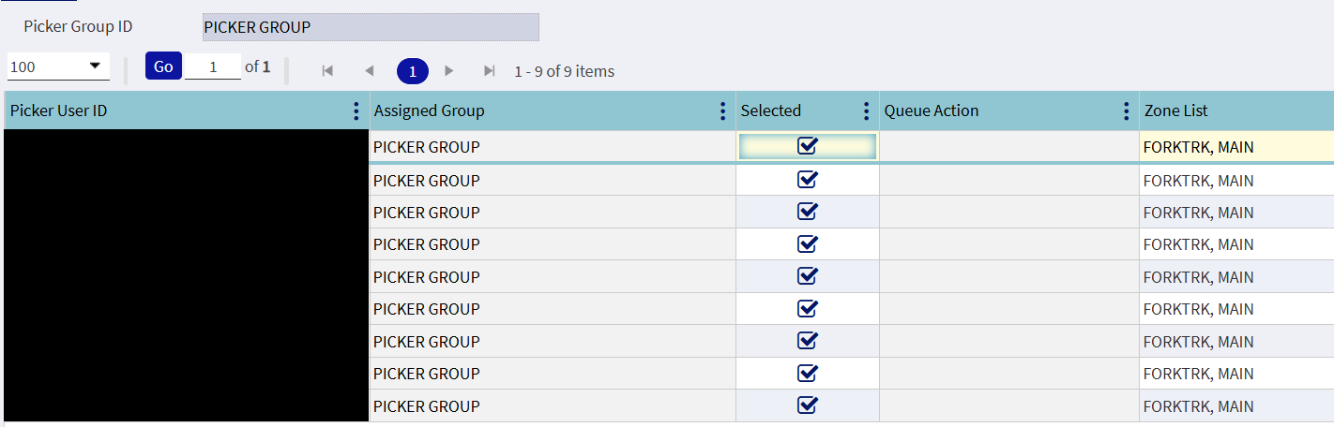
Creating Visibility
Notes:
Matt to show

Slide 20
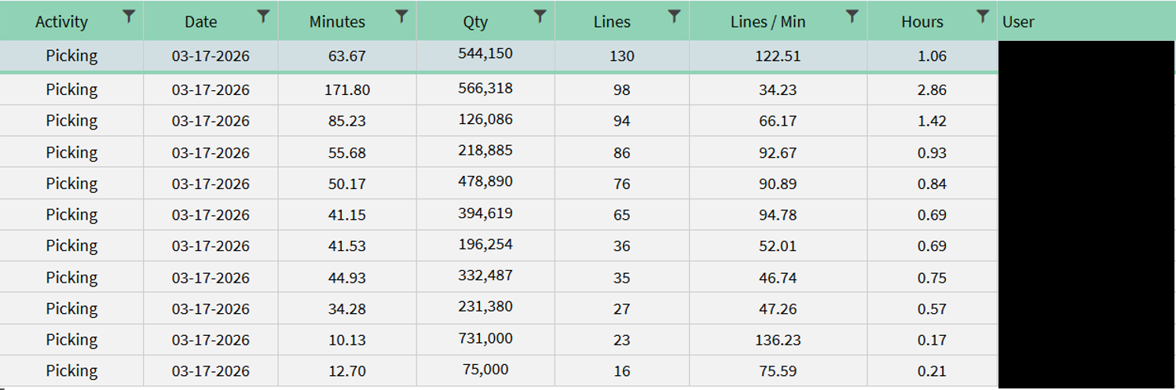
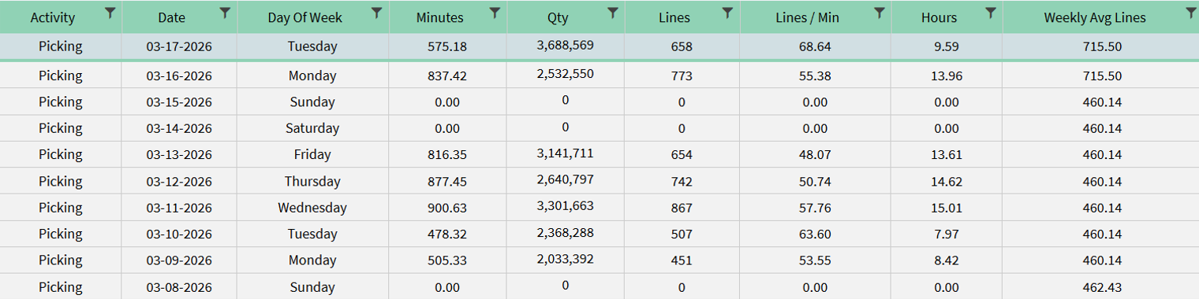
Creating Visibility
Notes:
Matt to show

Slide 21
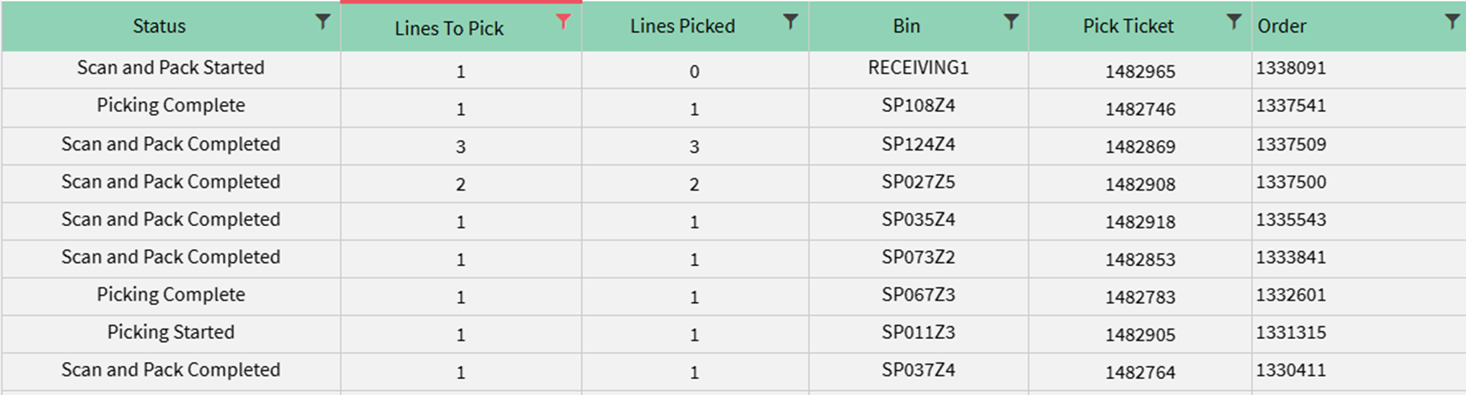
Creating Visibility
Notes:
Matt to show

Slide 22
System visibility
The problem
What changes
Supervisor has to walk the floor to know what's happening.
Always one step behind.
Workbench queries. Picker groups. Auto-assignment.
Transaction traceability.
Manage by data. Not by instinct.
Notes:
Matthew walks through a fully traced receiving workflow.

Slide 23
The U/I Problem
The problem
Too many steps. Manual entry where a scan should work.
Operators find a faster path around the system.
Notes:
Matt to summarize the problem

Slide 24
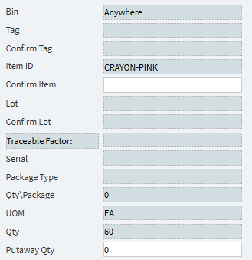
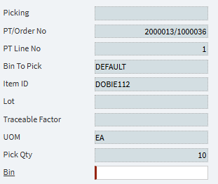
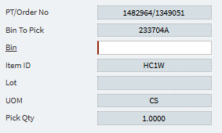
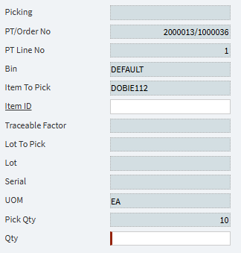
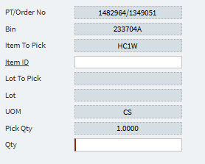
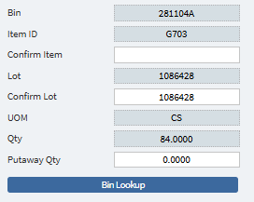
Simple U/I Improvements
Notes:
Matt to show

Slide 25
Optimized U/I
The problem
What changes
Too many steps. Manual entry where a scan should work.
Operators find a faster path around the system.
Strip each transaction back to what the operator needs.
Every step that can be a scan is a scan.
The system earns compliance.
Notes:
Matt’s summary slide

Slide 26
These levers compound.
The biggest gains come from the right combination — not one in isolation.
Notes:
Andrew – to use this slide to help transition to next section

Slide 27

The Management Challenge
Notes:
Andrew

Slide 28
What’s the Real Score
The stated scorecard
The real scorecard
Accuracy
Fill rate
Shrinkage
On-time dispatch
Speed.
Get it out.
Get it out fast.
Notes:
Andrew

Slide 29
It's not a character flaw.
It's a rational response to the incentive structure above the warehouse floor.
Notes:
Andrew

Slide 30
"What would get you in trouble around here?"
If the answer is only about speed — the configuration work is already at risk.
Notes:
Andrew

Slide 31

Case Study
350,000 sq ft. 75% manual. WWMS licensed. Largely unused.
US-based medical supply wholesaler.
Notes:
Matthew to describe
350,000 sq ft. 75% manual. WWMS licensed. Largely unused. - US-based medical supply wholesaler.
Four things broken at once.
No receiving traceability. No pick path logic. No workforce visibility. No trust in the inventory record.
Palletised receiving. Sequenced pick paths. Scan at every step.
Each of the five levers — applied to a real operation.
"The technical work and the culture work happened at the same time. Not sequentially. That matters — because one without the other wouldn't have held."
3.5 higher throughput.
Weekend work eliminated
System and management visibility
Single source of truth.

Slide 32
A Quick Diagnostic
1
When someone puts inventory away, they often decide where it goes.
2
You couldn’t trace a pick sequence as a logical sequenced path through your warehouse
3
Nobody could answer “what is the status of a pick ticket” without referring to pieces of paper
4
There are handoff points where no scan happens and no system record is created.
5
Could a new employee rapidly use the scanner without significant instruction
6
The most important informal measures in your warehouse are speed – at the cost of all else
Notes:
Andrew

Slide 33
Your score card
0-1
2-3
4+
Genuinely well configured. Well done.
Specific gaps. Addressable. You know where to focus.
It’s costing your company real money. Today.
Notes:
Andrew

Slide 34
If you scored four or more, we'd like to talk .
And if you were lost. . . Let’s help you get unlost.
andrew@conveyance36.com
matthew.lucas@conveyance365.com
An Epicor Platinum Elite Partner

Slide 35
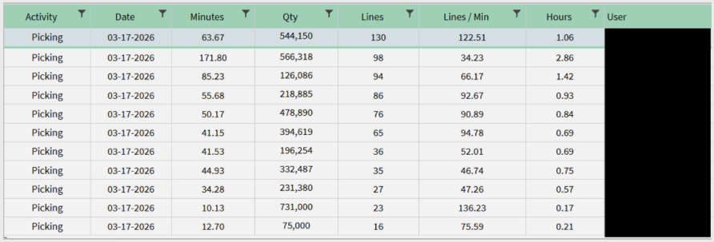

Pick Ticket Visibility Portal - Picker, Lines, Time
An Epicor Platinum Elite Partner

