Slide 1
Navigating Tariffs with Prophet 21 A Distributor Roundtable

Slide 2
Who We Are
Andrew Taylor
Co-Founder, CRO
Val Ross
Director of Application Consulting
Evan Foster
Sr. Sales Consultant, Co-Owner
Katie Harding
Marketing Director
Conveyance365.com
An Epicor Platinum Partner
hello@conveyance365.com

Slide 3
Your Reality
Notes:
Rapidly changing environment
Lots of uncertainty
Imperfect solutions
Competing priorities (“don’t lose money”, “can’t pass on all tariffs” “need an efficient way to do this”, “needs to be accurate”, “needs to be good enough”)

Slide 4
A Roundtable
Notes:
No neat and tidy answers – sharing our best practices, hearing from you, considering other options,
Potential subsequent roundtable
Interactive – chat Q&A, hand raise,
Acknowledge that 25.1 release has some features.

Slide 5
Key Questions
How accurate do I need my tariff charge for customers to be?
How do I want to recognize the cost – COGS or a separate GL?
How much visibility do I want my customers to have?
How much manual maintenance do I want to do in probably a medium-term horizon of uncertainty and changing conditions?
Notes:
Note for Andrew: -How/is your supplier passing on tariffs to you.
-Do you want to pass tariff to your customer. (If no, this could be a need cost only solution and not pricing)

Slide 6
Survey Results
Are we passing on tariffs to our customers?
100%
Yes

Slide 7
Survey Results
How do you want to account for the cost increase?
COGS
10%
90%
Separate GL account

Slide 8
Survey Results
Where do you want visibility for the customer?
None
10%
All levels (quote, acknowledgment, invoice)
20%
40%
Quote
30%
Invoice

Slide 9
Survey Results
What level of visibility do you want for the customer?
Sub-total summary
40%
60%
Line Level

Slide 10
Standard Alternatives
COGS
(Landed Cost)
Other Charge Item
Manually applied
Accessory item (manual/auto)
Freight/handling charge maintenance
Sub-total
Tariff charge visible to customer
“False” inventory item
Manually applied
Accessory item (manual/auto)
Cost Mgt
Visibility
Line detail
Tariff charge is invisible to customer
Price increase
GL Expense
(Charges/expense added to the vendor invoice or manual voucher)
The challenge to all these solutions is that they are highly manual

Slide 11
Automation Options

Slide 12
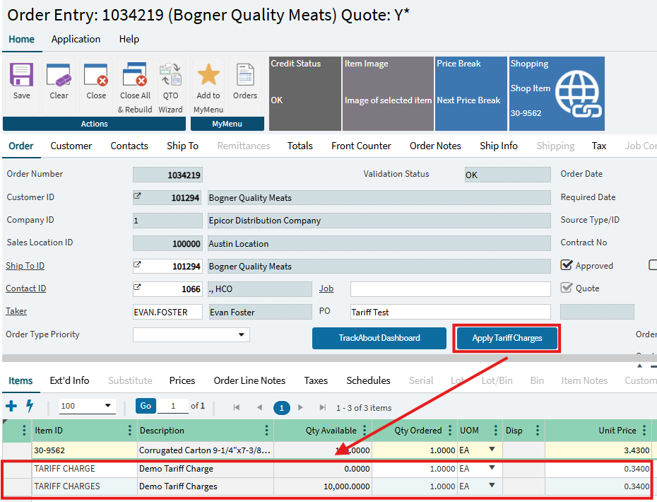
Automation Options
A button triggered business rule
When clicked, the rule would review the associated tariff (by supplier, item grouping (product group, discount group, etc.)
After determining the tariff, automatically add an OCI or "false" inventory
* Assumes business rules package

Slide 13
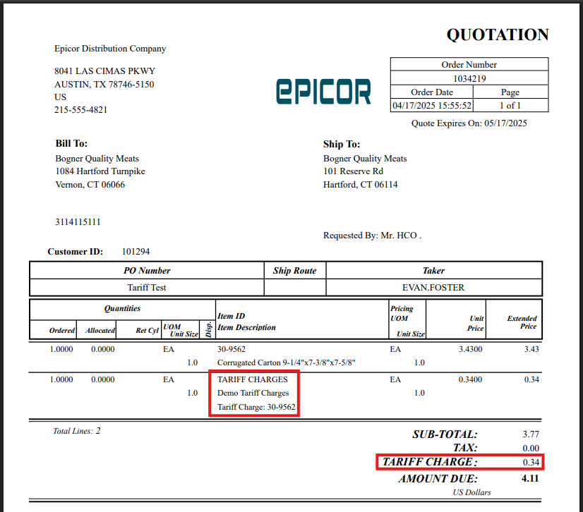
Automation Options
OCI displays as subtotal
"False" item displays as a line item
"False" item can have an extended description linking the associated item.

Slide 14
Edge Cases
How about direct ship?
OCI can be added to the customer order and applied to the customer invoice without being added to the Purchase Order
Orders with multiple shipments or partial stock partial DS will require separate invoicing steps
What are the implications for assemblies?
Consider if the fee changes for complete assemblies purchased vs components used to build the product
Tariff should be added at the component level if accounting for different rates by item or item group
Tariff could be added to the order if charging fee that applies to the entire assembly
Be aware of profitability reporting and/or commission implications (highly dependent on individual approach)
What about pre-tariff inventory to be sold?
Edit Inventory Cost can be used if you want to increase your inventory value to match replacement cost for existing inventory
A fee can be added to open orders to charge the fee regardless of how you handle cost
Flat charge by order, customer or supplier (freight handling/charge maintenance)
Be aware of tax implications for tariffs as they vary by state https://www.wipfli.com/insights/articles/tax-taxes-and-tariffs-an-overview-of-sales-tax-implications
Notes:
Is there an alternative “standard functionality” approach we have missed?

Slide 15
Q&A
Can Eco Fees be used for Tariffs?
No, eco fees are a flat charge per base unit not a percentage making it difficult to automate the correct amounts
Eco fees rely on Tax Jurisdictions for their application creating challenges when trying to align with tariffs.
Notes:
This is not a baseline solution and is primarily used in Canada.
Eco Fees are not compatible with Avalara or imported orders
Can Scheduled Release be used with OCIs?
Yes, but need qty of more than 1 to add to release
You can also adjust OCI amount in shipping if qty is greater than 1 and select how may are applied to each shipment
How can different tariff rates be added?
Create multiple OCI or "fake" inventory items with description updated to reflect each separate charge
Will OCI appear on Purchase Order?
No, OCI will allow you to add a charge to a sales order without receiving into inventory but cannot be added to a PO.
How do you know what charges to add when rates differ?
Manually calculate and train all staff entering orders or automate via business rules or mandatory accessory items
Will 25.1 release include tariff functionality?
Epicor is working on a solution, but no release date or details about how it will work are currently available.
Notes:
Is there an alternative “standard functionality” approach we have missed?

Slide 16
Conveyance365.com
hello@conveyance365.com
andrew@conveyance365.com, evan@conveyance365.com, val@conveyance365.com, katie@conveyance365.com

Slide 17
Pro's/Con's
 | Landed Cost/Price Increase | Other Charge | “False” Inventory | Price Increase
Attributes | Bakes in cost to COGS (MAC or FIFO) | No warehouse implications | Line item visible Applies to multiple shipments | “Set and forget”
Effort | Impacts only subsequently received inventory | Manual add and calculation (mitigate with mandatory accessory item) All OCI appears on first shipment (if multiple and qty 1) Only displays at sub-total | Manual add and calculation (mitigate with mandatory accessory item) Must "pick" and "ship" in warehouse | Not visible to customer Requires item groupings that align with tariff

